Slide 1
Key Stage Two
Cold Norton Primary School 2023-2024
Mr Lewis (Maple Class), Mrs Wilson / Mrs Williams (Holly Class), Ms Kent (Pine Class)

Slide 2
Our aims to discuss in this session:
Homework – Multiplication tables, spellings and reading. Weekly practise for testing.
Curriculum overviews
English reading/writing examples
Twinkl Go
Year 6 SATS
Year 4 MTC
Questions.

Slide 3
Homework
All Key Stage 2 children are expected to complete home learning in the following areas:
-Spellings:
In reading records
Practise at home for spellings quizzes - Monday.
-Reading:
Read daily
Heard by an adult until fully fluent, at least 3x a week, preferably daily.
A little comment and signature in their record books is very helpful.
Encourage different text types.
(phonics, blending, context, comprehension, fluency, expression)
-Times Table Rockstars:
Use this app at least 10minutes, 3x a week.
There are a mix of games, some with timers, some without.
*Y4 will be taking part in the multiplication check, in which they need to complete answers within 6 seconds. “Soundcheck” on TTRS is a very similar format to the test.*

Slide 4
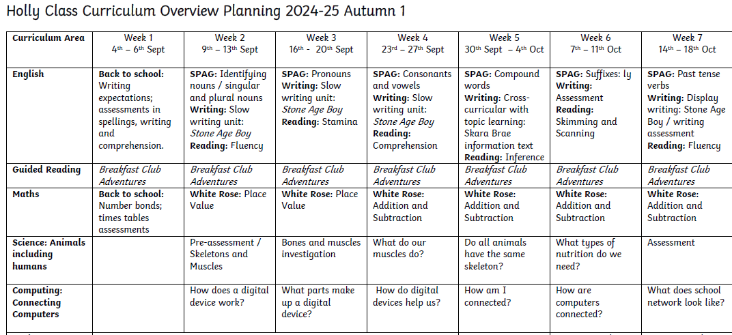
Curriculum
The curriculum overview for each half term can be found on the website, on each class page.
It will let you know which topics they are covering for each subject, on which week. Here is an example:

Slide 5
English – Guided Reading and Comprehension – Key Skills:
Whole class guided reading lessons within the classroom, promoting exposure to further vocabulary and practising on pupils’ stamina of reading
Key vocabulary is picked out before reading, to establish definitions of words and support pupils’ understanding of what they will read
Pupils are expected to follow reading and be ready to take over reading aloud, promoting enthusiasm for reading and aiding confidence
Varied text types will be used throughout the year
Comprehension skills also taught in separate English lessons: Fluency, Skimming & Scanning, Comprehension & Retrieval

Slide 6
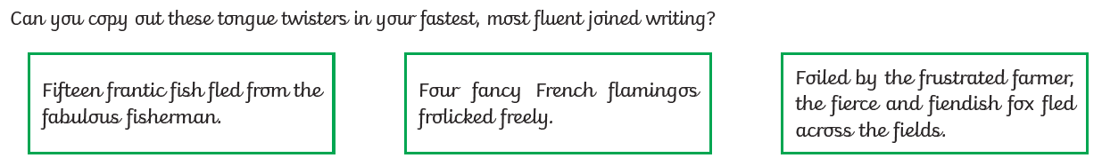
English Handwriting:
  Handwriting – TWINKL guide – cursive (not continuous cursive)
  Weekly lessons
  Interventions as appropriate
  Examples:

Slide 7
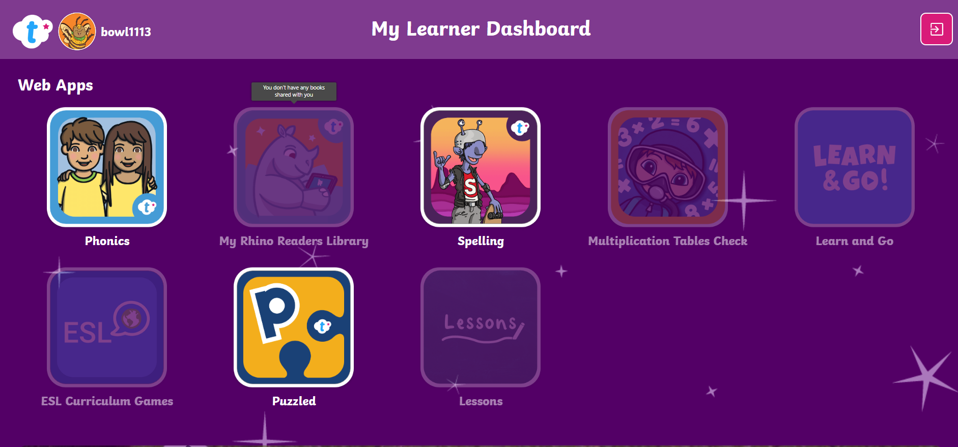
Twinkl Go
Learner log ins to come home.
Access to phonics, spelling, puzzle games
NOT a homework, however, opportunity to broaden skills, greater depth study, learn facts related to topics etc.

Slide 8
Year 6 SATS
Week commencing Monday 12th May
Maths – Three papers Arithmetic (36 questions, 30mins) Reasoning 2 (23 questions, 40mins) and Reasoning 3 (23 questions, 40mins).
English – Spelling (20 questions), Punctuation/Grammar (50 questions, 45mins) and Reading (three texts, 39 questions, 60mins)
English – Writing assessed by Teacher.
Moderation of writing to ensure consistency across assessment – potential for external moderation.

Slide 9

Year 4 MTC
Year 4 multiplication check – week commencing Monday 3rd June
Expectation of 25 questions at 6 seconds per question.
Testing 12 x 12
Please use TTRS “Soundcheck” to practise your timings!

Slide 10
Questions?

