Slide 1

Welcome to our Early Years and Key Stage 1 Support Workshop
Phonics
Comprehension
Phonics Screening Check
Year 2 SATs

Slide 2
Phonemes
We follow Twinkl phonics.
A phoneme is a single unit of sound made up from 1 or more letters.
Letters are learnt using their phonetic sound, not name.
We must get pronunciation of letter sounds correct so words can be decoded.
In Reception, each phoneme (sound) is taught alongside an action and a song to make it more memorable.

Slide 3
Phonemes
With Twinkl Phonics, phonemes are taught in 6 progressive levels.
Children start with the single letter sounds.
They do not learn in alphabetical order.
Once the children have learnt the first few phonemes, they are able to start decoding words.

Slide 4
Blending
Blending is a strategy used when decoding (reading) words.
Scan the word, looking for digraphs / trigraphs.
Point at each grapheme as you say the sound.
Run your finger under the whole word as you blend it.

Slide 5
Segmenting
Segmenting is used when writing or spelling words.
Orally segment by saying each phoneme in the word whilst tallying the sounds on your hand.
Draw sound dashes for the phonemes counted.
Write one grapheme on each dash.
Check by blending the phonemes written.

Slide 6
Digraphs
Digraphs are two letters that make one unit of sound (phoneme).
They must be read as a whole sound, not individual letter sounds:
sh not s h
sh o p

Slide 7
Trigraphs
Trigraphs are three letters that make one unit of sound (phoneme).
They must be read as a whole sound, not individual letter sounds:
igh not i g h
n igh t

Slide 8
Split Digraphs
Split digraphs are two letters – a vowel and an e – which make one unit of sound (phoneme), but are split up around another letter.
They must be read as a whole sound, not individual letter sounds:
i-e not i e
t i m e

Slide 9
Tricky
Words
These are common words which the children will encounter in many of their books.
They may not be decodable (so please don’t try and decode them!), or they may include phonemes which the children have not yet learnt.
Children need to become familiar with these words so that they can recognise them when reading.

Slide 10
Comprehension
There is more to reading than just decoding words.
Many children read without real understanding.
In order to enjoy books, we need to understand them.
Talk about what you have read - ask your child questions:
  retrieval
  inference
  opinion.

Slide 11
Books
From school;
Decodable reading book:
to be read daily at home
books will be changed twice a week
Sharing books:
Once a week, your child will bring home a sharing book to keep for the week.

Slide 12
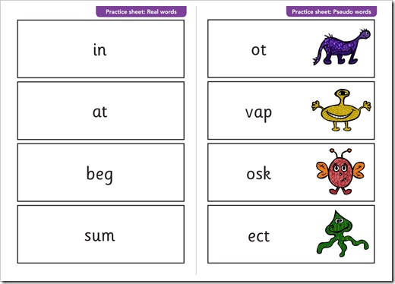
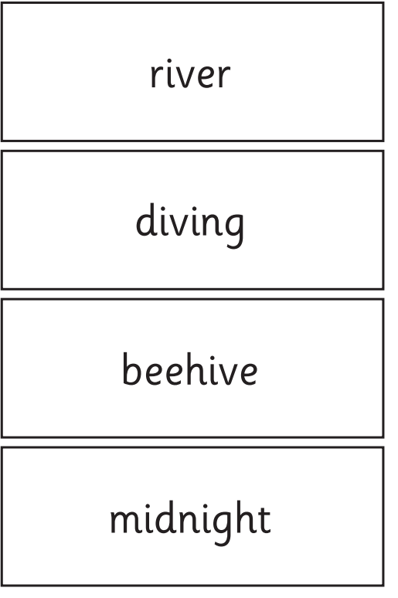
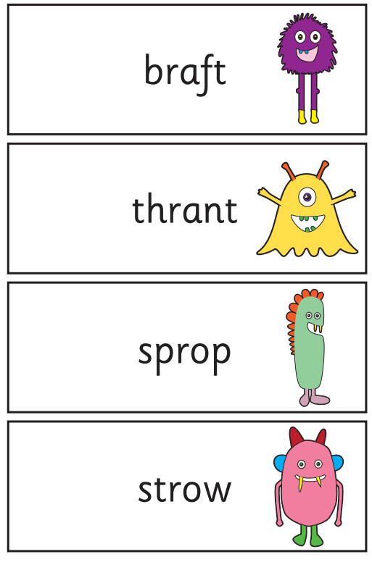
The Phonics Screening Check
takes place in June
for all Year 1 children and any Year 2s who didn’t reach the threshold the previous year
40 phonetically decodable words, both real and ‘alien’

Slide 13
Spellings
Spellings will be sent home weekly.
They are linked to our phonics scheme.
Children in Key Stage 1 will be tested weekly on a Monday.

Slide 14
Maths at home
Make maths as fun and practical as possible.
Numbots for Reception and Key Stage 1.
Times Tables Rock Stars for Year 2 (from January).

Slide 15
Year 2 SATs
Timetabled tests.
SATS papers are provided to the school, but the data/results are not reported – for school assessment only.
Two reading papers (one has a separate reading booklet).
Arithmetic and reasoning papers for Maths.
Spelling test
SPAG test.
Writing is assessed by the teachers directly from independent work from the year.

Slide 16
Any questions?

